Slide 1
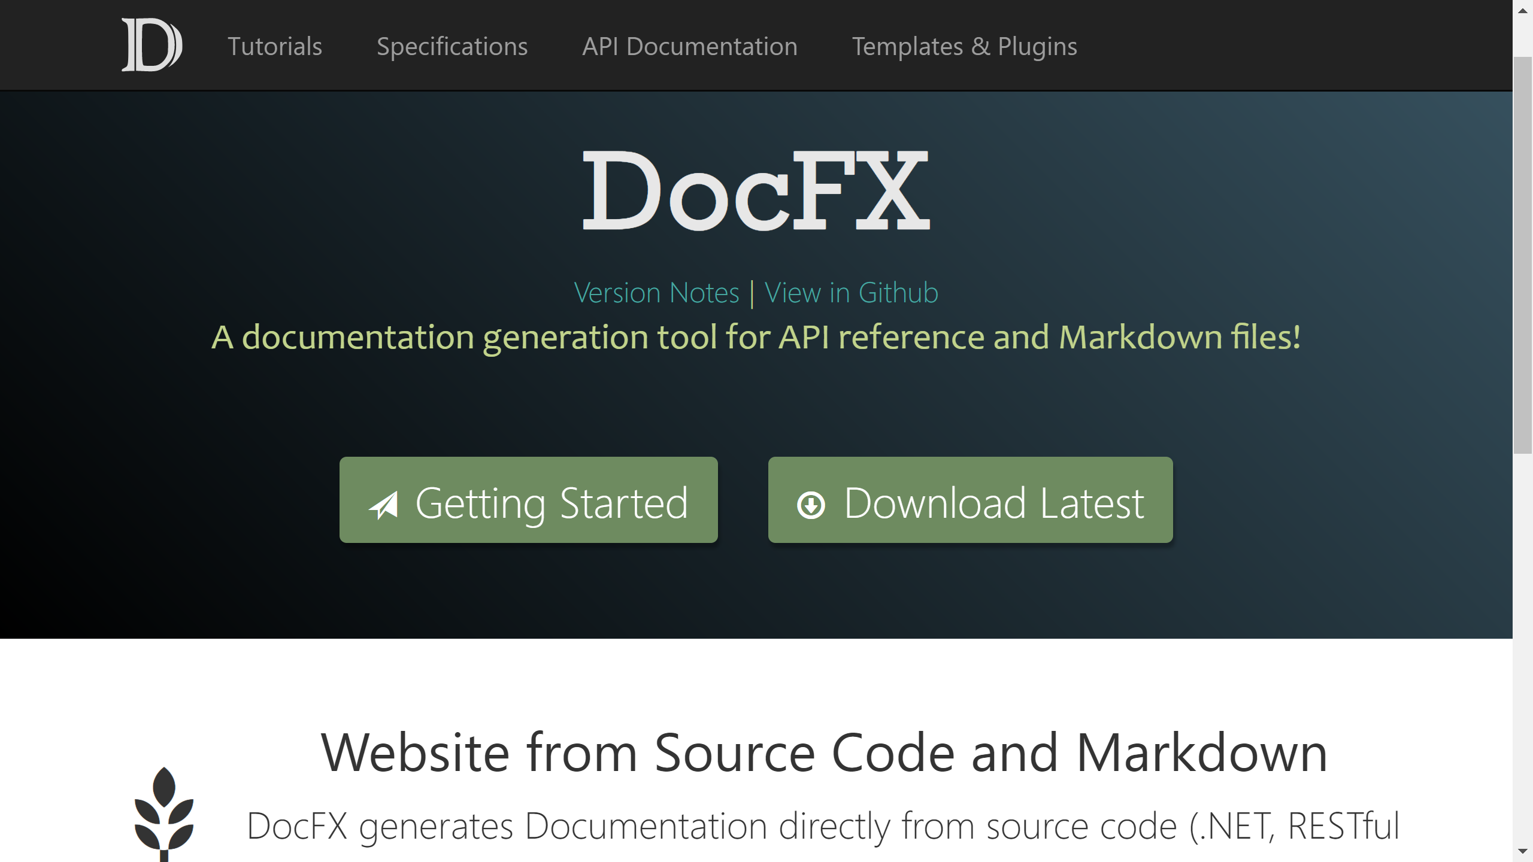
Introduction to DocFX
DocFX
The evolutionary history
& lessons learnt

Slide 2
Agenda
Basic Introduction
DocFX Walkthrough (DEMOs)
Inside DocFX
Evolutionary History
Lessons learnt

Slide 3
Basic Introduction
What is DocFX

Slide 4
What is DocFX
A tool to generate
Website
PDF file
From
Source code
.NET
REST Swagger file
Other languages…
Markdown files
Together

Slide 5
Website + PDF (Demo)
GitHub integration
Able to track back to source code
Encourage contribution
Demo:
Create simple csharp project => run docfx –serve => website
Push project to github => run docfx –serve => website with github integration
Using docfx init, Add conceptual file, add overwrite file
Generate PDF

Slide 6

Basic Introduction
Why call it DocFX
Inspired by CoreFX, stands for Document Framework
Codename: docfx
Open source
https://github.com/dotnet/docfx
701 Stars

Slide 7
Open Source Involvements
701 Stars
40+ external contributors
Around 10 active contributors, issues, PRs, gitter.com
@jonskeet, @bitbonk, @dlech, @AustinWise, @pascalberger, @richardschneider, @ferventcoder, @agc93, …
Collect feedbacks from
Feethub.com: a feature upvoting system
Disqus.com: commenting system

Slide 8
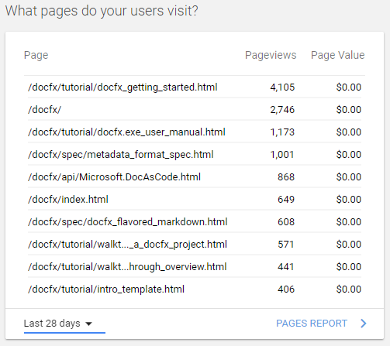
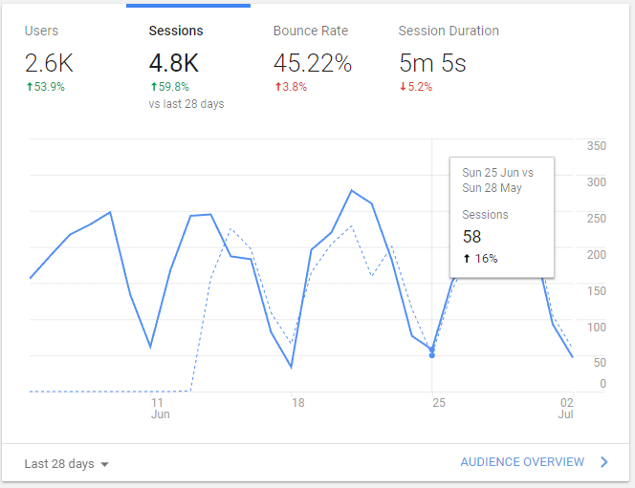
Homepage http://dotnet.github.io/docfx/
Generated by DocFX,
Google Analysis

Slide 9
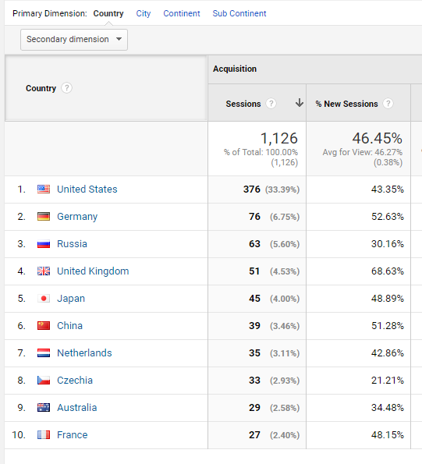
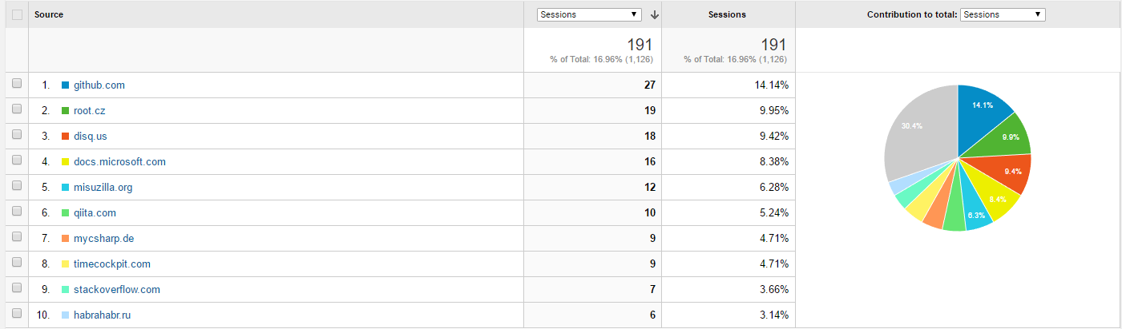

Slide 10
Use cases

Slide 11
Usage statistics
As a local tool, not easy to count
The default template generates webpages with a metadata
<meta name="generator" content="docfx 2.19.2.0">
Search github.com with “docfx.json in:path”: overwhelmed by MicrosoftDocs…

Slide 12
Key points of DocFX
Inputs can always be mapped to a data model
Data model + template => output
Markdown file
DocFX

Slide 13
What DocFX do for you
Map input to a data model
Key features
Markdown => html
Validate and resolve file links
Validate and Resolve cross references
Validate and resolve external references

Slide 14
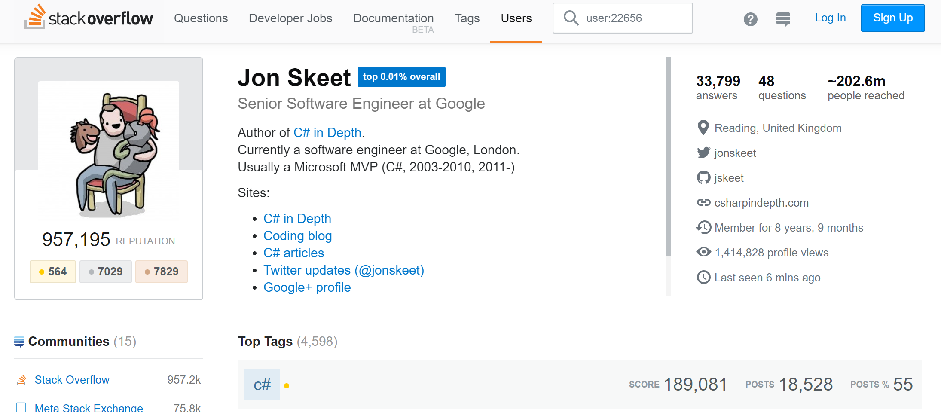
Use cases
Jon Skeet https://stackoverflow.com/users/22656/jon-skeet
Google Cloud Client Libraries for .NET https://googlecloudplatform.github.io/google-cloud-dotnet/docs/index.html
His personal project http://nodatime.org/

Slide 15
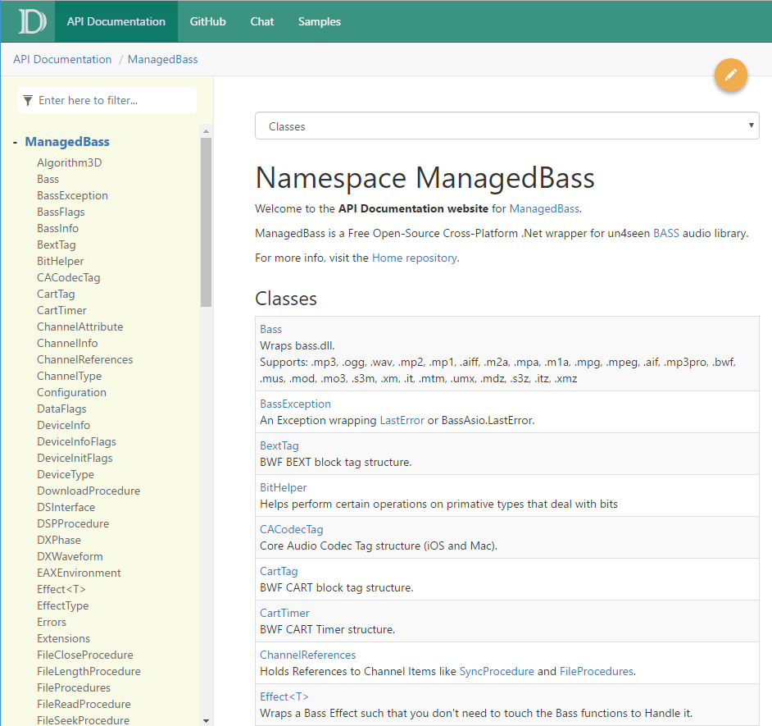
Use cases
Mathew with template https://github.com/MathewSachin/docfx-tmpl

Slide 16
Use case

Slide 17
Eager for contributions

